Slide 1
Integrated Platforms for e-learning aimed at capacity building for the global health workforce National Medical College Network – An Integrated eLearning Platform at National Level
Prof. S. K. Mishra Head, Dept. of Endocrine Surgery &
Faculty I/C, SGPGI Telemedicine Programme
National Coordinator, National Medical College Network (NMCN) Project
Sanjay Gandhi Postgraduate Institute of Medical Sciences (SGPGIMS), Lucknow, India Email: skmishra@sgpgi.ac.in / skmishra_1956@yahoo.com

Slide 2
Population Growth

Slide 3
Half of the world’s population growth is expected to be concentrated in nine countries
Most LMIC
31% increase in surgical work between 2001 and 202
The current and projected global demand for surgeons is increasing substantially
Novel ways to bridge the gap of skilled healthcare providers should be explored
Etzioni et. al The aging population and its impact on the surgery workforce. Ann Surg 2003

Slide 4
A Crisis- shortage of workforce
Minimum 228 skilled health professionals per 100 000 population
Below this - health workforce crisis ( WHO 2006)
83 countries are below this threshold ( Lancet commission 2015)
Five billion people worldwide do not have access to safe and affordable surgery and anaesthesia when they need it
Low and middle income countries (LMICs) are the worst affected
Only 6 percent of the 313 million surgical procedures that take place worldwide each year occur in the poorest countries
Sub-Saharan Africa has 24% of the world’s disease burden, but only 3% of the world’s health workers
Lancet commission on global surgery 2015

Slide 5
There is shortage + Inequity
Lack of medicines and supplies
Restrictive policies (responsibilities of nurses and mid-level workers, retirement ages)
Inadequate support for community health workers, caregivers
Failure to update health workers’ skills and knowledge
Poor management and lack of regular, supportive supervision
Lack of key skills such as human resource, financial, and program management
E learning applications in low and middle income countries limited
Doubts have been expressed regarding the sustainability
Cost-effectiveness in developing country set up- most burning question asked by the opponents of Tele-medicine.
E Learning

Slide 6
What should be best model for LMICs
Hence long term engagement needed which may not be possible with conventional way
Innovative ideas need to be applied to meet the skill gap using available resources

Slide 7
Distant Learning Modules used
Tele-pathology
Tele-consultation and treatment planning
Tele-radiology
Tele-CME and workshops
Transmission of digital patient records
Interactive video discussion
Interactive video lectures
Live surgery demonstrations in real time
Modules

Slide 8
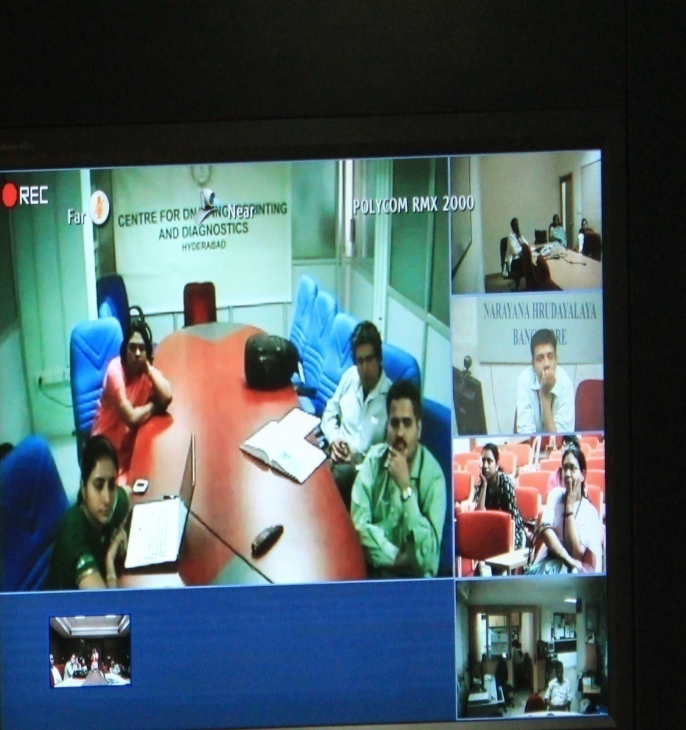
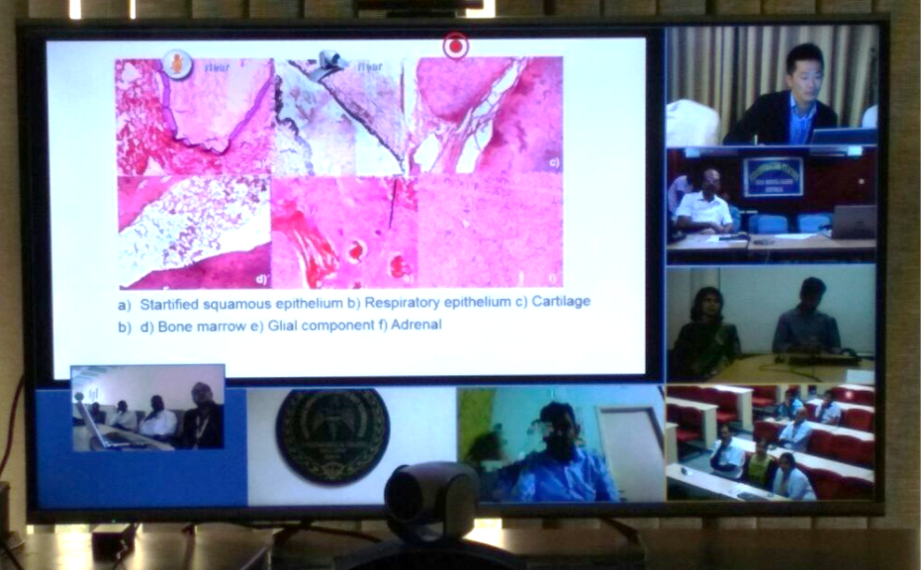
Collaborative Learning- Multipoint real time interactive Special Interest Group (SIG)
Medical Genetics connected to PGIMER, Chandigarh, Sir Ganga Ram Hospital, New Delhi, AIIMS, New Delhi, CMC Vellore, CDFD Hyderabad & Narayana Hrudayalaya, Bangalore
Endocrine Surgery during one of the event connected to various medical colleges

Slide 9
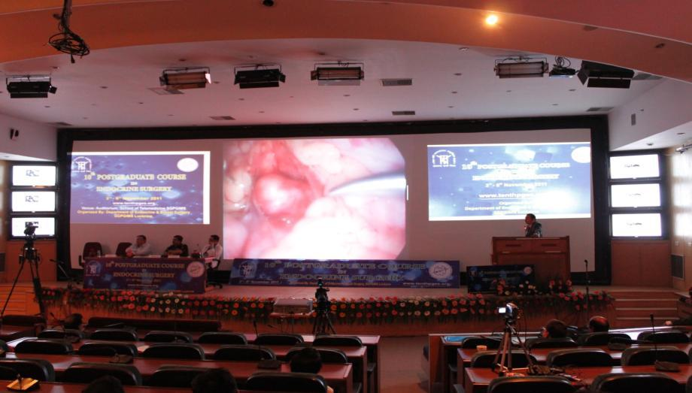
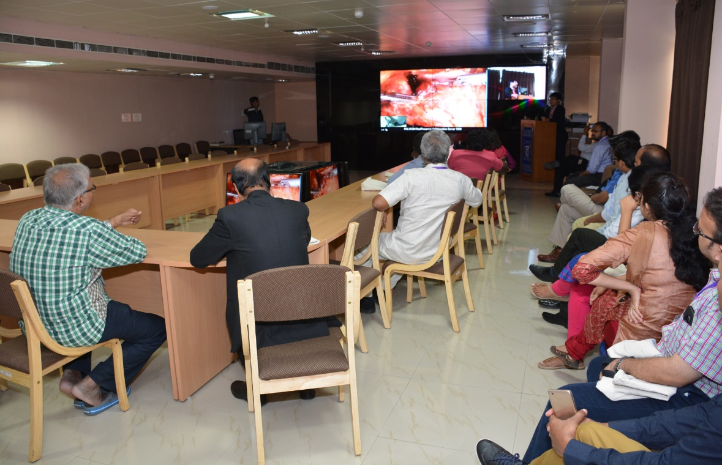
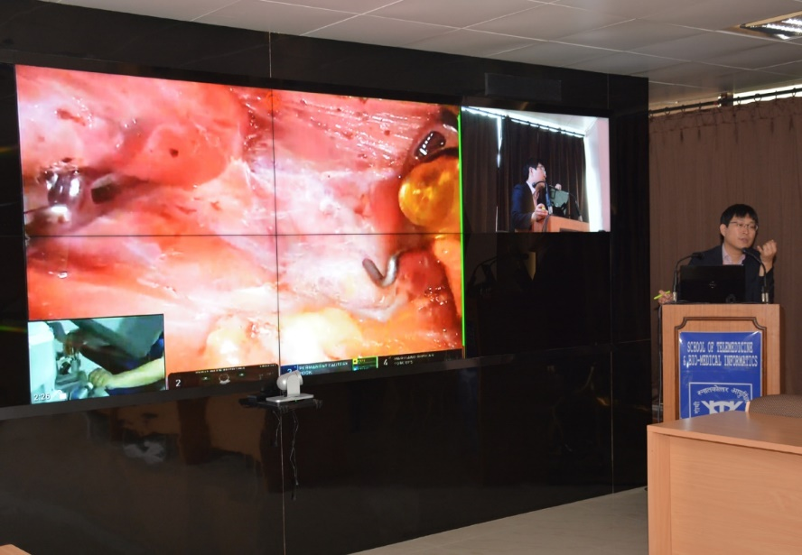
Integrated Networked Lecture Theatre/ Auditorium
eTumour Board for Live Surgical Skill Sharing & Clinical Decision Support System (CDSS)
Live Robotic Surgery Transmission

Slide 10
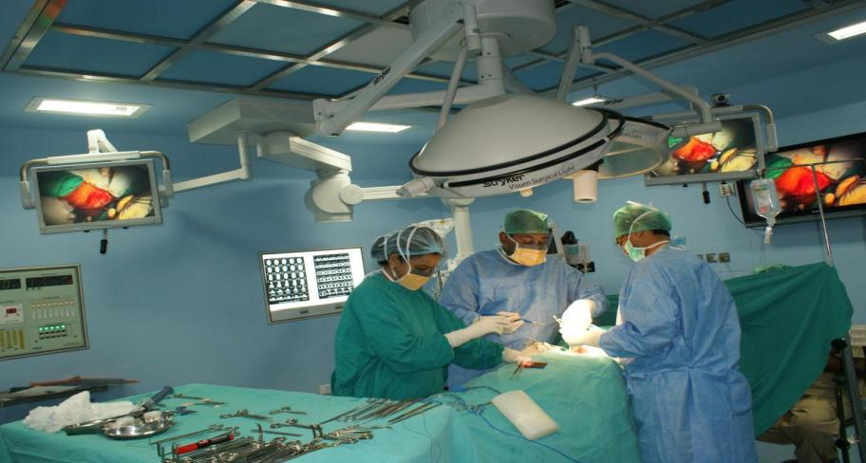
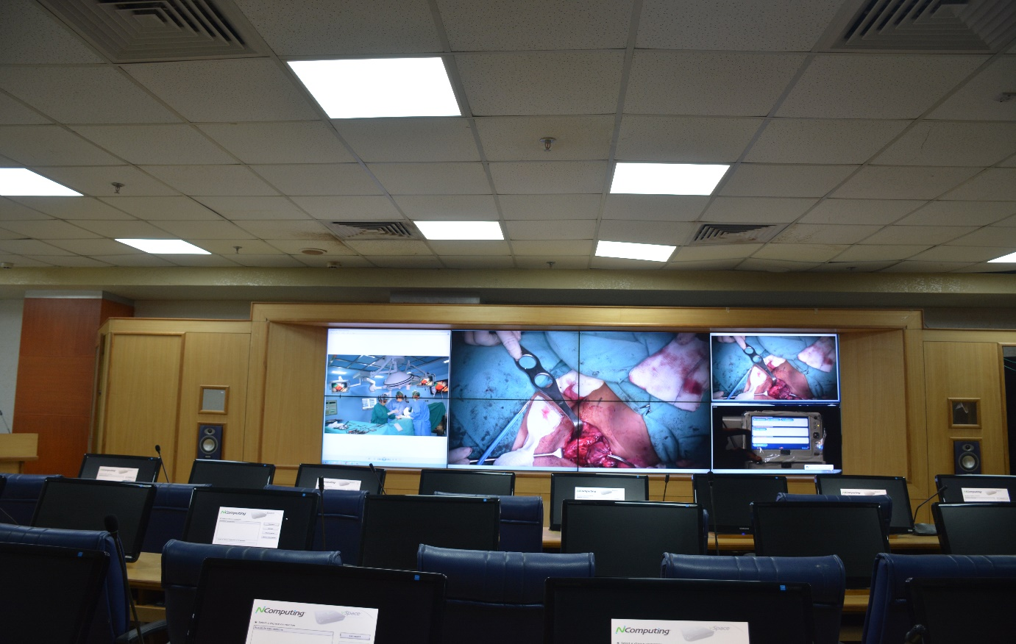
Integrated Digital Operation Theatre
Surgical Telepresence Suite

Slide 11
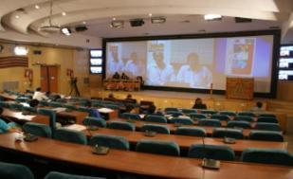
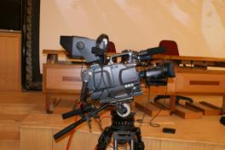
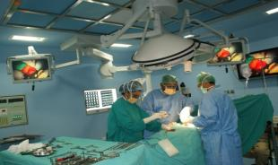
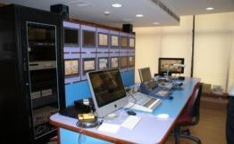
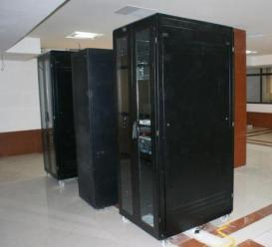
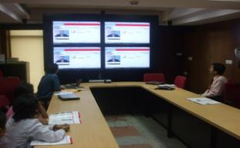
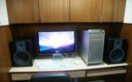
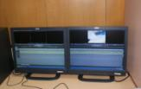
Knowledge Processing Edit/Voice Over
SGPGI Knowledge Engineering Architecture
Hi-Tech Lecture Theatre
Broadcast Quality Studio Camera
Network Monitoring Hub
Integrated Operation Theatre
Production Control Unit (PCR)
Video Conferencing Suite
Edit Stations
Data Server

Slide 12
Institution based Knowledge Repository SGPGI Knowledge Park

Slide 13
NATIONAL MEDICAL COLLEGE NETWORK (NMCN)
50 Govt. Medical Colleges having National Knowledge Network (NKN) shall be networked for Tele-CME, Tele-specialist consultations and Access to Digital Library etc.
INFRASTRUCTURE SETUP
Creation of following facilities at Medical College
Tele-consultation Facility
Digital Medical Lecture Theatre
E-Learning and Digital Library
OBJECTIVES
Tele-Consultation
Tele-Follow ups
EHR Creation of Patients
Remote Mentoring
Creating Learning Resources

Slide 14
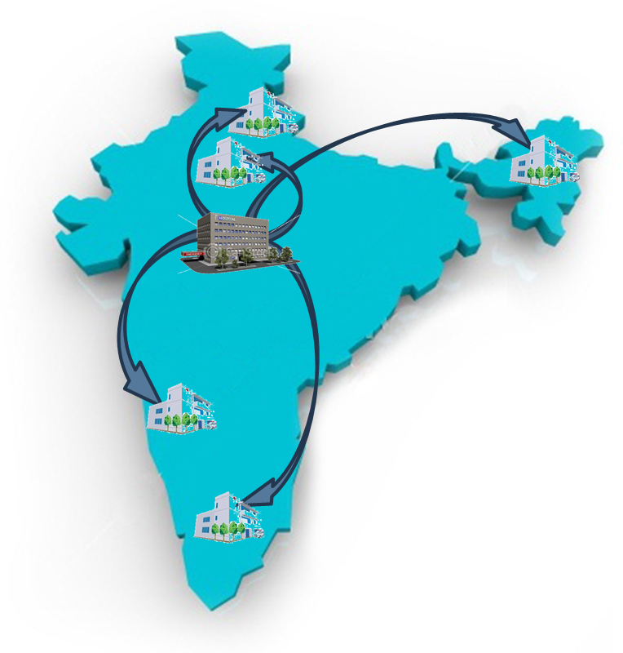
National Medical College Network (NMCN)
Scalable , Hierarchal, Secured IPv6 compatible Network Riding over NKN
 | Region | Medical College | State
I | National Resource Centre | SGPGI, Lucknow, UP | Uttar Pradesh, Odisha
II | Regional Resource Centers
i. | Northern Region | PGIMER, Chandigarh | Chandigarh, Himachal Pradesh, Haryana, J&K and Punjab
ii. | Southern Region | JIPMER, Pondicherry | Puducherry, Andhra Pradesh, Telangana and Tamil Nadu
iii. | Eastern Region | IMS, BHU, Varanasi, U.P. | Bihar, Jharkhand, West Bengal and A&N islands
iv. | Western Region | KEM Medical College &Hospital, Mumbai, Maharashtra | Maharashtra, Gujarat, Goa, Daman &Diu , Dadra & Nagar Haveli
v. | Central Region | AIIMS, New Delhi | Delhi, Chhattisgarh, Madhya Pradesh, Rajasthan, and Uttarakhand
vi. | North-eastern Region | NEIGRIHMS, Shillong, Meghalaya | Meghalaya, Assam, Manipur, Tripura, Nagaland, Sikkim, Mizoram & Arunachal Pradesh
vii. | Southern Region | Government Medical College, Trivandrum, Kerala | Kerala, Karnataka and Lakshadweep
01 National Resource Center
07 Regional Resource Centers
42 Medical Colleges
29 States/UTs
7500 student at a time

Slide 15
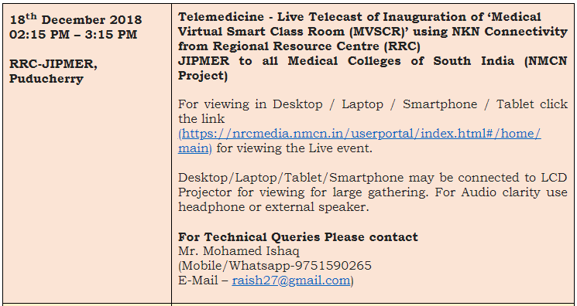
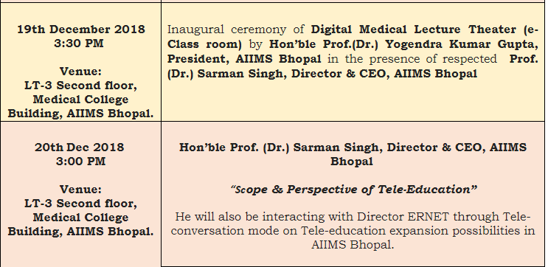
OPERATIONS OVERVIEW
Test lectures being transmitted using NMCN project within 50 Medical Colleges

Slide 16
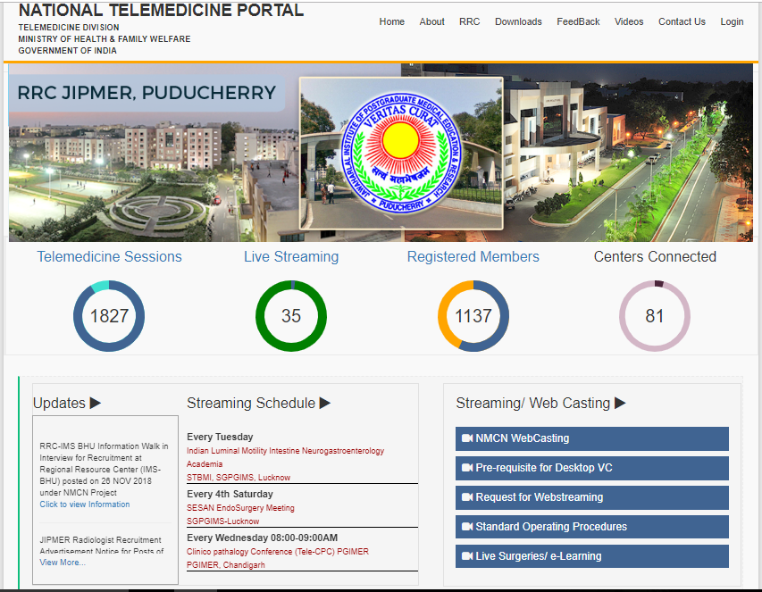
NMCN Portal

Slide 17
OUTCOMES ENVISAGED
Medical Content generation at Colleges from eminent Professors
Anytime Anywhere access of content for Students
Demonstrate live surgery/Live Medical Procedures from Operation Theatre
Advantages in terms of flexible education imparting and gaining
Distribute the education uniformly
More efficiency and high educational standards to the students and teaching staffs
Reducing the Costs of educational process

Slide 18
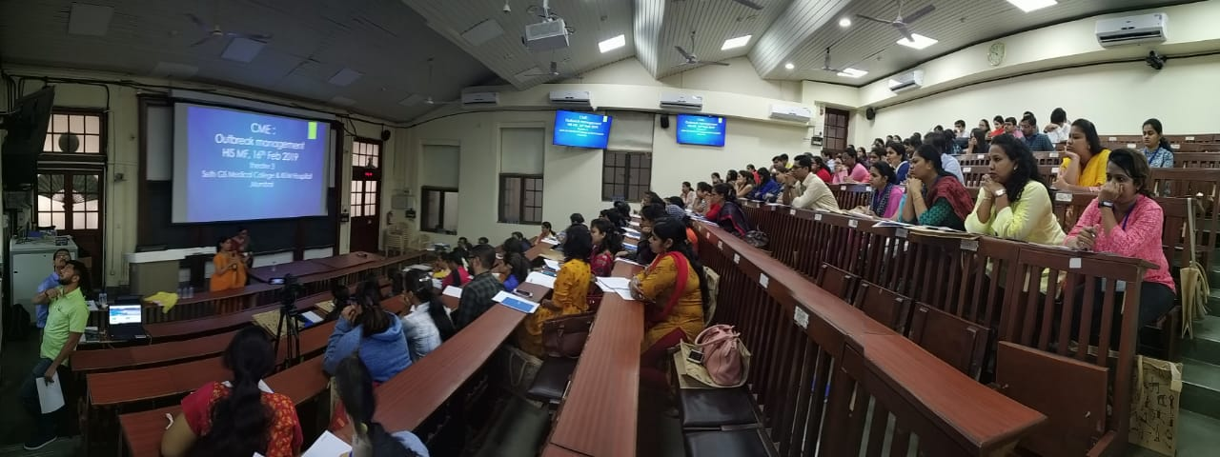
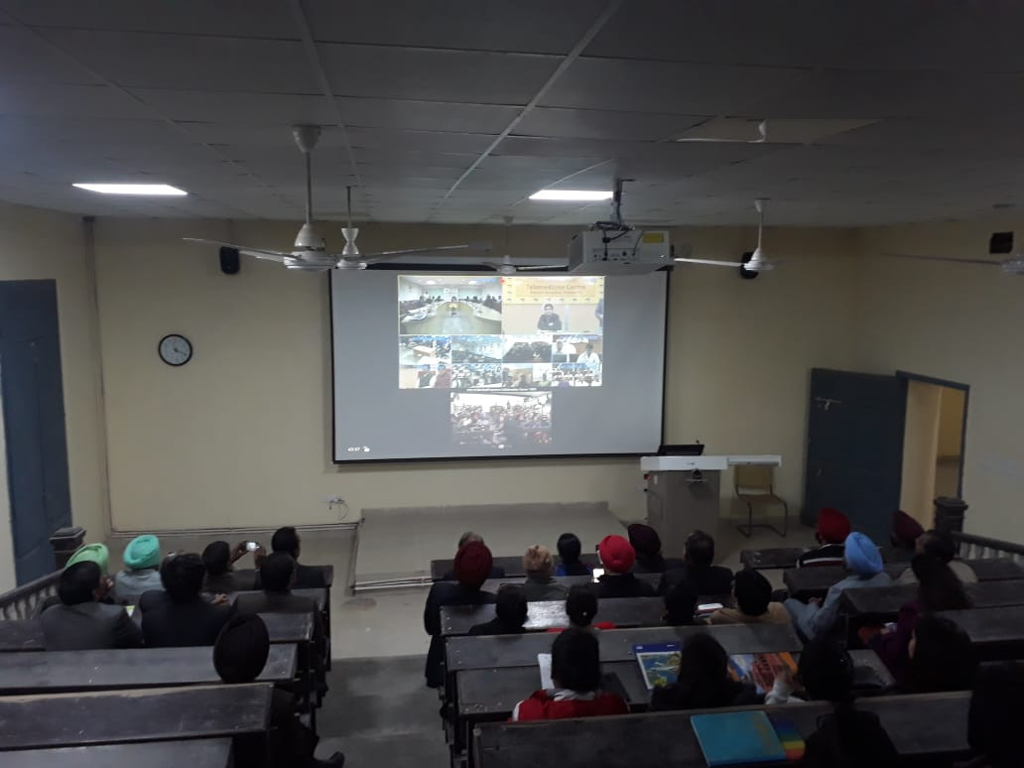
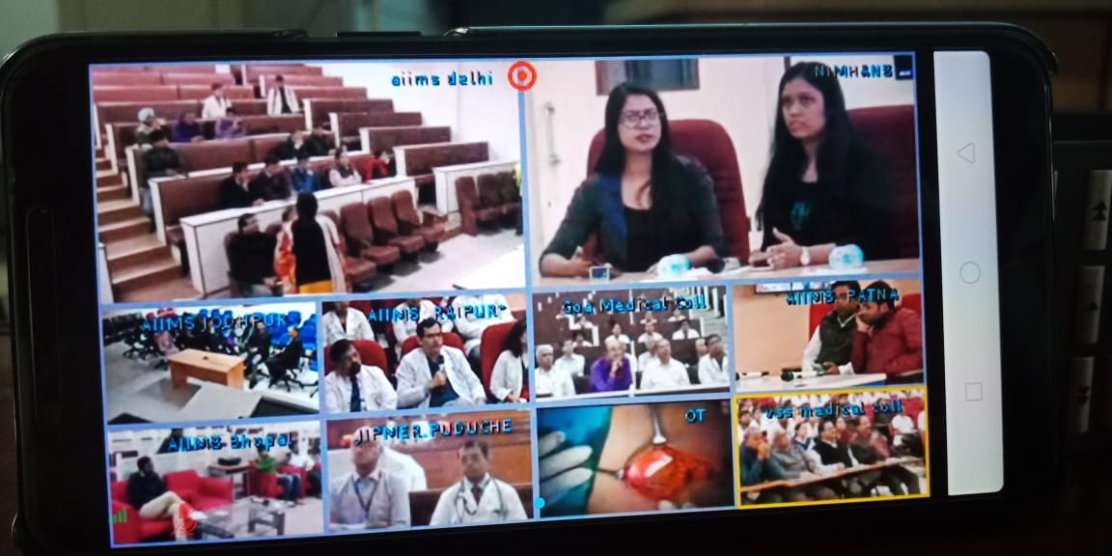
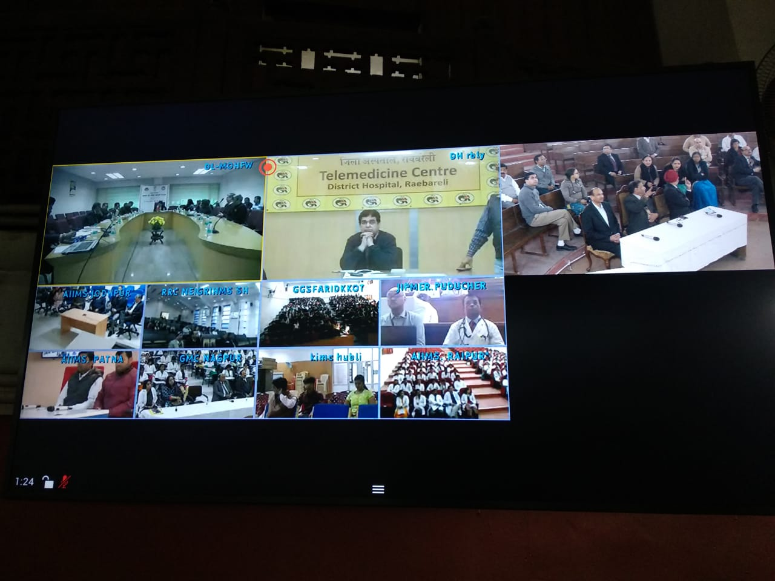
Ongoing session at NMCN Smart Classroom

Slide 19
FUTURE - VISION
NMCN
Scheme
M-eDX
Live Lectures
Online Medical Education
Certification courses
Training Modules
Information dissemination platform
Live surgery
Animated Videos
50 MEDICAL COLLEGES
Services
Services
Services
Tele-Radiology
Specialty
Tele-Consultation
Tele-CMEs
PAN INDIA COVERAGE
Government Healthcare Institutions
Health & Wellness Centres
State Medical Colleges
DH/CHC/
PHC
Aspirational Districts
Govt. Doctors/ANMs/ASHA/
Paramedics
AYUSH

Slide 20
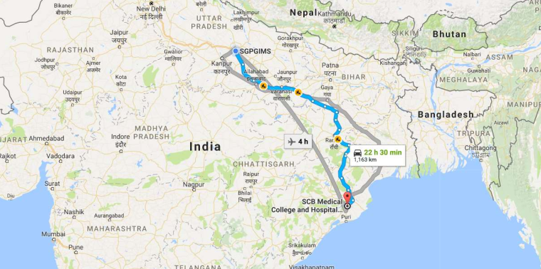
SGPGI Experience
Innovative concept was mooted to train General Surgeon with Endocrine Surgery knowledge and Skill
Short term fellowship (03 months) followed by long term engagement using Collaborative Technologies
Network & System which are universally available and robust enough to support remote training and skill development were used
PoC : Study Location

Slide 21
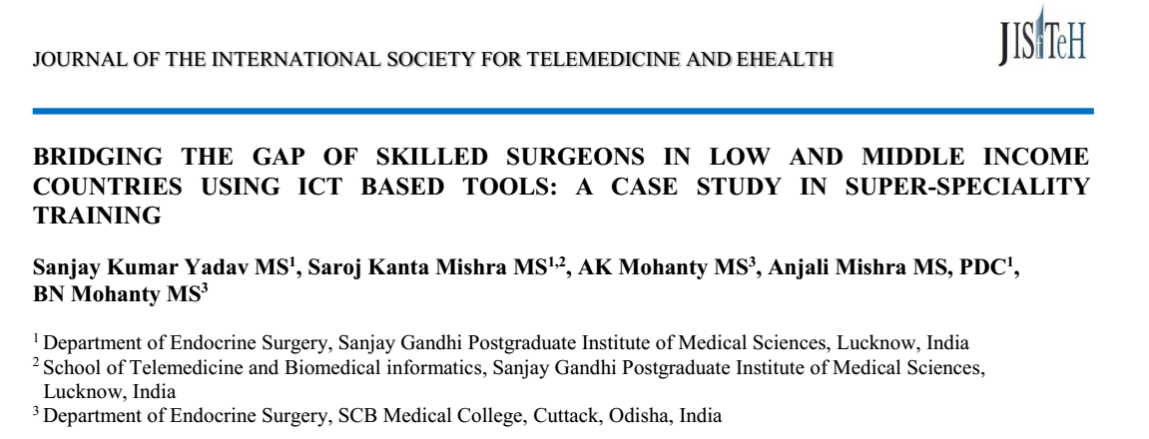
Results: Over the last 11 years, 199 endocrine surgeries per annum were performed with most being thyroid cases as compared with 119 surgeries per annum during the previous five years. Parathyroid and adrenal cases increased significantly during this period (p <0.001). Rates of temporary and permanent vocal cord palsy (1.7% and 0%), hypocalcaemia (5.9% and 1.1%) were comparable with high volume centres. Based on the quantum, safety and quality outcome of endocrine surgery the provincial government has approved creation of a super-speciality department of endocrine surgery in Cuttack.
Conclusion: Sustained engagement using tele-mentoring can transfer surgical skills to needy surgeons and enable them to match the expertise of mentors. This model can be replicated in other specialities in a cost effective way to develop specialised human resources for healthcare, in particular in LMICs.

Slide 22
FUTURE - VISION
National consultation on “Designing Framework for e-Learning” in Feb 2019
Schedule based Collaborative Learning Programme will be deployed
Web based Learning system in the line of eDX will be in place
Design and develop innovative learning modules
National level archive of medical learning material
Electronic Books and Journals to students and researchers in due course
Integration of NMCN with national programmes like Collab DDS, Health Access at Aspirational districts, My Health Record, Ayushman Bharat etc. will be taken up in due course of time

Slide 23
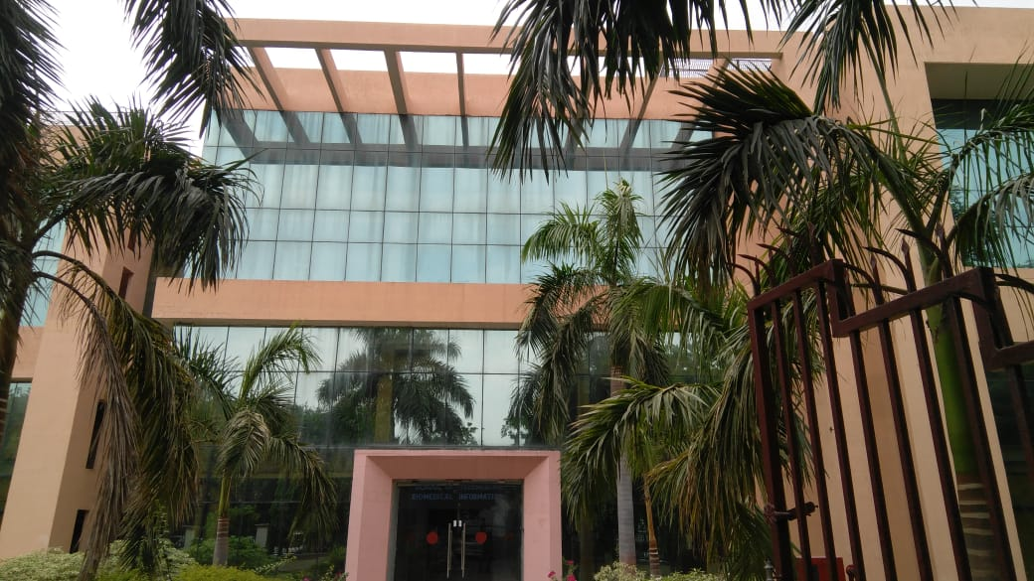
Thank you...
School of Telemedicine & Biomedical Informatics, SGPGIMS, Lucknow

